Slide 1

Music for Mind
Team : Alt F5

Slide 2
If your idea were a tweet
Brief your idea in no more than 200 characters.
We love how #music brings different generations together. Releasing Stress Through the Power of Music. #MusicTherapy #MusicForMind
Explain if your idea is unique or if it is an improvement of an existing solution
As per scriptures - Love, Joy, Wonder, Courage, Peace, Sadness, Anger, Fear and Disgust are the total 9 emotions of the human life. This solution will help in balancing these emotions.
It may make your day better by telling jokes, making music recommendations depending on your current mood.
This solution can become a good companion when you are not feeling happy.

Slide 3
Explain the problem you are tackling
More than 300 million people of all ages around the world live with depression as per 2021-22 report. It can lead to multiple disease and sometimes suicide.

Slide 4
Explain your solution
We created a system that will recognize your face expression by uploading your face picture.
This will analyze your current mood / emotions and based on that we are showing some useful videos / music to cheers you.
Purpose of this application is to make your happy & balance your emotions.
Keep Calm! Because Life is a camera so keep smiling ☺

Slide 5
Research references/Additional information
Links:
1) TensorFlow.js is a library for machine learning in JavaScript: https://www.tensorflow.org/js
2) Face-API: https://justadudewhohacks.github.io/face-api.js/docs/index.html
3) YouTube data playlist API : https://developers.google.com/youtube/v3/docs/playlists
4) YouTube player API: https://developers.google.com/youtube/iframe_api_reference

Slide 6
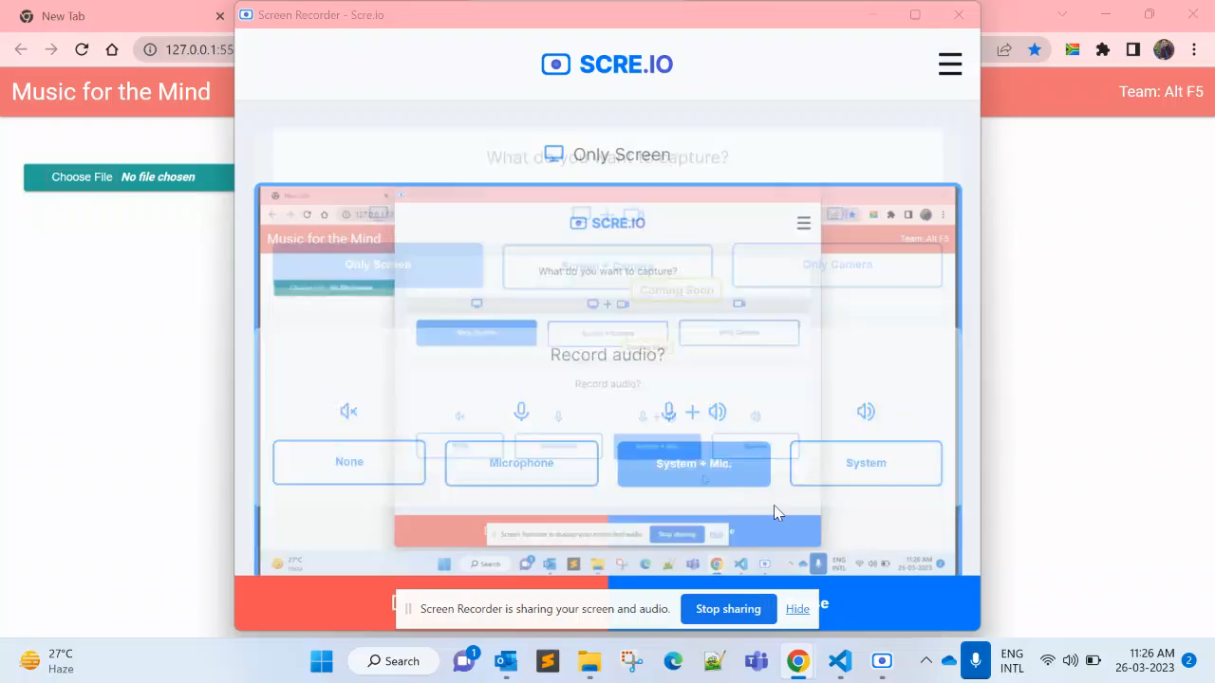
Solution Video
Video is also in Zip folder.

Slide 7
Environment setup
Explain what steps must be followed for an environment setup
1) TensorFlow.js AI ML API
2) JavaScript / HTML - Language
3) Node JS - Server to run application.
4) VS Code - Editor
5) Create developer account on YouTube to access APIs.
5) YouTube Player - To Play YouTube Videos.
6) YouTube Data API - To Get Playlist based on your Mood and emotions.

Slide 8
Team details
Team Lead
mohit.saxena@nagarro.com
Mohit Saxena
mohit.saxena@nagarro.com
Rohit Sikhwal
rohit.sikhwal@nagarro.com
Rohan
rohan.bhatia@nagarro.com
Hemeandra Jain
hemeandra.jain@nagarro.com
Dipesh Chaurasia
dipesh.chaurasia@nagarro.com

